Slide 1


UNIVERSITY OF BASRA
COLLEGE OF MEDICINE
DEPARTMENT OF PATHOLOGY AND FORENSIC Medicine
White blood cells
Part II
Dr. Ala’a A.Razak Abood
Iraqi Board of Haematopathology

Slide 2


Slide 3
Definition:
group of conditions arising from marrow stem cells and characterized by clonal proliferation of one or more haemopoietic components in the bone marrow and, in many cases, the liver and spleen.

Slide 4
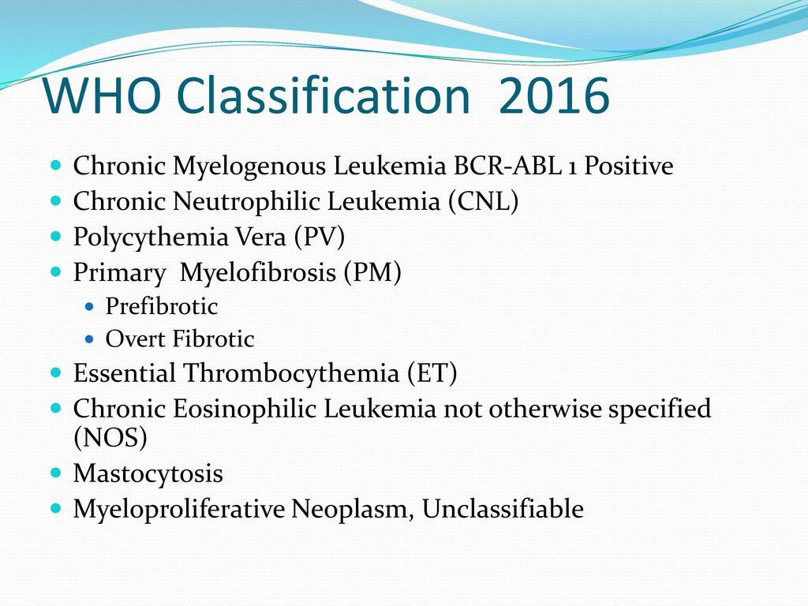
Classification:

Slide 5
pathogenesis:

Slide 6
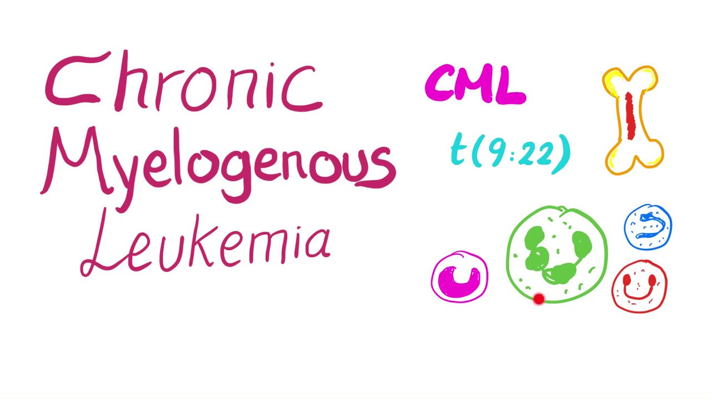

Slide 7
Definition:
It is a clonal disorder of a pluripotent stem cell. The disease accounts for around 15% of leukaemias and may occur at any age.
Associated with a characteristic presence of the Philadelphia (Ph) chromosome; which results from the t(9;22).

Slide 8
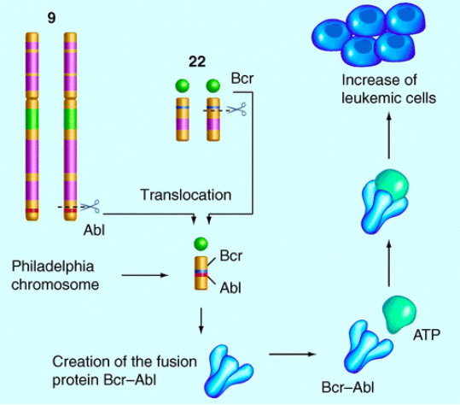
pathogenesis:
pathogenesis:

Slide 9
Phases of CML:
Advanced phase |  | Chronic phase
Blastic phase | Accelerated phase

Slide 10
Clinical features of chronic phase CML:
1- Hypermetabolism symptoms.
2- Splenomegaly.
3- features of anaemia.
4- Bruising, epistaxis, menorrhagia or haemorrhage from other sites.
5- Gout or renal impairment.
6- Rare symptoms include visual disturbances and priapism.

Slide 11
Laboratory findings in chronic phase CML:

Slide 12
Blastic transformation:

Slide 13


Slide 14
Definition:
Increase in red cell volume caused by a clonal malignancy of a marrow stem cell.
The Val617Phe JAK2 mutation is present in haemopoietic cells in over 95% of patients

Slide 15
Clinical features:

Slide 16
Lab findings:

Slide 17


Slide 18
Definition:
A condition in which there is a sustained increase in platelet count, because of megakaryocyte proliferation and overproduction of platelets.

Slide 19
Clinical features:
Thrombosis and haemorrhage.
Erythromelalgia

Slide 20
Lab findings:

Slide 21


Slide 22
Definition:
It is a progressive generalized reactive fibrosis of the bone marrow associated with the development of haemopoiesis in the spleen and liver.

Slide 23
Clinical features:

Slide 24
Lab findings:

Slide 25


